Slide 1
aN Individualized Check in/Check out System to Support Students When Their Behavior Impedes Learning
Presented By Rebecca Jensen, M.S. SPED
March 19, 2019

Slide 2
Check IN/Check OUT is an ACCEPTED PBIS Intervention
A more generalized check in/check out with a behavior report card is a widely used Tier 2 support with a growing research base.
It is a recommended strategy for PBIS Tier 2 teams in the state of South Dakota.
This approach can be successfully individualized to address behavior on the Tier 3 level to support students who have behavior that is interfering with their learning.

Slide 3
Why AN Individualized check in/Check out with Behavior Report Card?
Higher doses of Specific Positive Feedback
Higher doses of Specific Corrective Feedback
Higher doses of adult attention
Specifically tailored to the student’s needs
Facilitates a predictable system of reinforcement
Great data source for progress monitoring!

Slide 4
When To Use this Individualized Approach
Students who have serious or aggressive behaviors/infractions
Chronic disruptive behavior
Students that struggle with attention and off task behavior.
Students with mild chronic behavior who need more emotional support or a positive adult relationship.
Students who struggle with self regulation.

Slide 5
Pre Implementation steps
Establish a relationship with the student.
Operationally define the maladaptive behavior(s).
Gather baseline data on frequency, intensity and duration.
Hypothesize the function of the behavior(s).
Consider appropriate replacement behavior(s).
Determine how the student is most effectively reinforced.

Slide 6
Establishing a Relationship
Based on a technique called “pairing” used by applied behavior analysts.
The goal is to make yourself and the environment a positive reinforcer.
First 2-3 times meetings with a new student are solely focused on building a relationship.
This time, invested in advance, will give a foundation to help shape the child’s behavior later on.

Slide 7
Arrange the environment to have a variety of items or activities of interest to the student.
If possible, get information about specific likes/interests in advance. (Dinosaurs, Yugioh, etc.)
Some general items to have on hand: kinetic sand, playdough, Uno, board games, Candyland, Jenga, match box cars, blocks, legos and our class pet.
Do the activity with the child, engaging him or her in play.

Slide 8
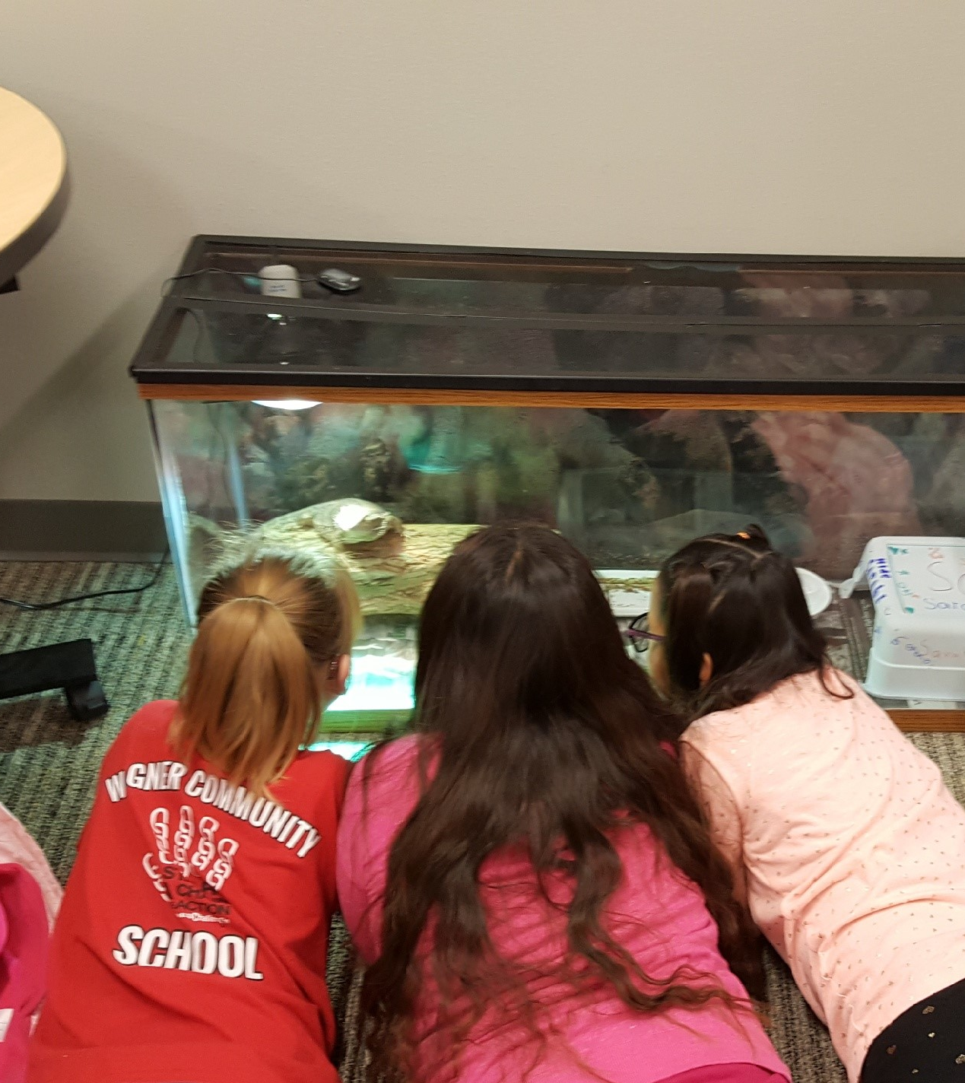

Slide 9
During the first few sessions, let the child guide the activities while you participate.
Make as few demands as possible.
Provide frequent verbal praise.

Slide 10
Operationally Define the Behavior
What does the behavior look like and sound like?
Your operational definition should allow a new observer to easily recognize, measure, and track the target behavior.
Non-Example: Joey is defiant.
Example: Joey yells “no” when given an instruction. He throws his books and pencils on the floor.

Slide 11
Gather Baseline Data
Before starting a behavior intervention of any kind, gather baseline data.
Record behavior over at least a three day period.
Use the median result as the baseline.

Slide 12
Methods of Gathering a Baseline
Behavior Snap or similar apps allow teachers to keep data on a target behavior in 15 second increments.
Behavior tracking sheets are used to record number of incidents, duration, and frequency.
SWIS or DDN data is another good source of information.

Slide 13
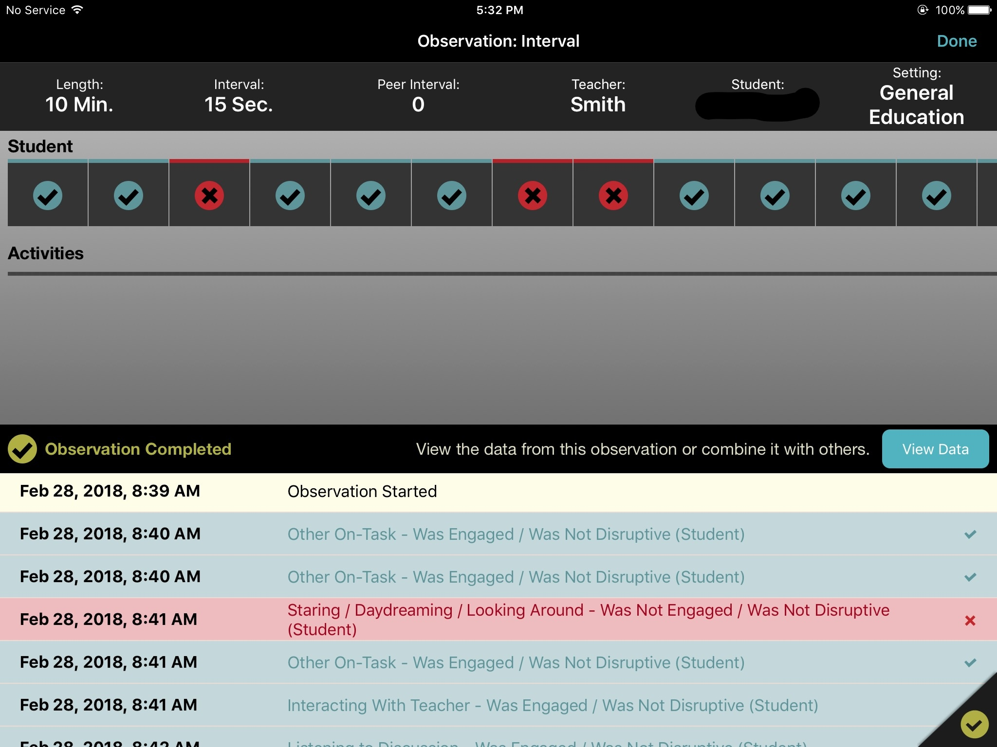
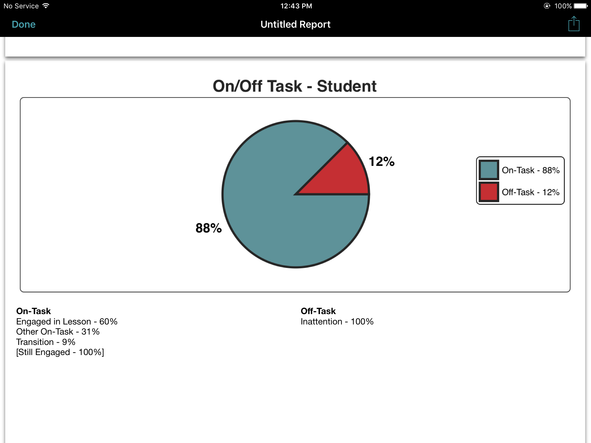
Behavior Snap Screen shots here

Slide 14
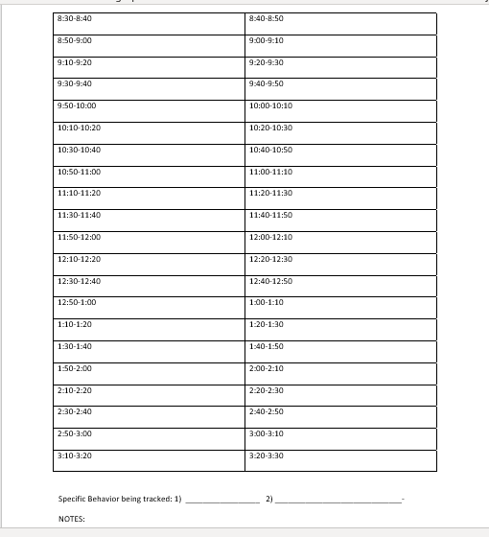
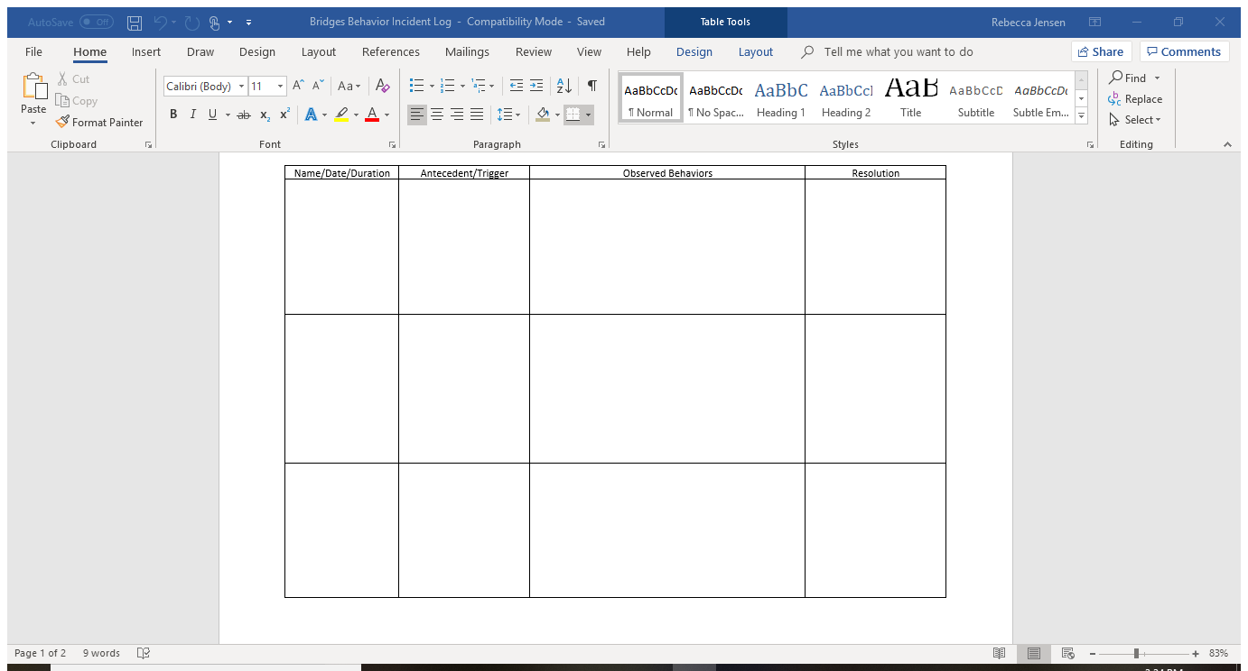
Data keeping sheets

Slide 15
Hypothesizing Function Of BeHavior
Function is the “why” of behavior, or what maintains the student’s maladaptive behavior.
Remember, all behavior is communication!

Slide 16
Use the ABC’s
  Antecedent-What happens directly before a behavior occurs.
  Behavior-Exactly what the behavior looks like. Use specific language
    Good Example: Student hit staff twice, kicked a desk and screamed for 10 minutes.
    Poor Example: Student was disruptive/aggressive.
  Consequence-What happens directly after a behavior.
    This does NOT mean punishment.

Slide 17
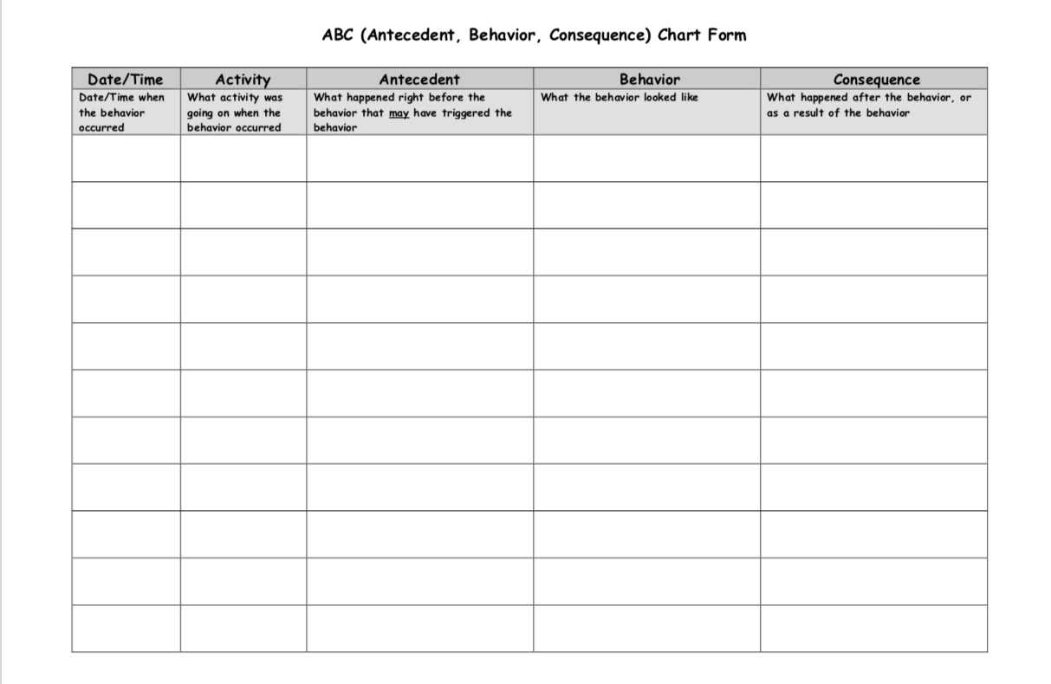
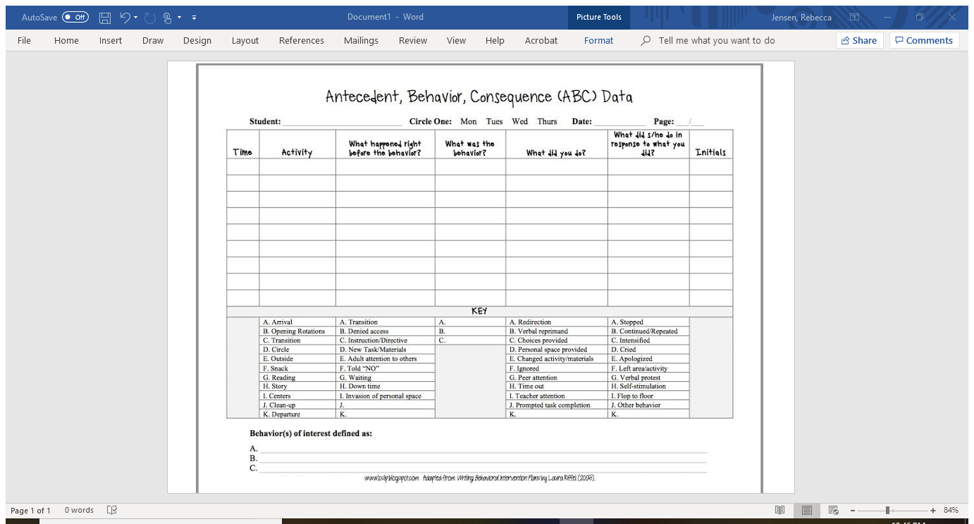

Slide 18
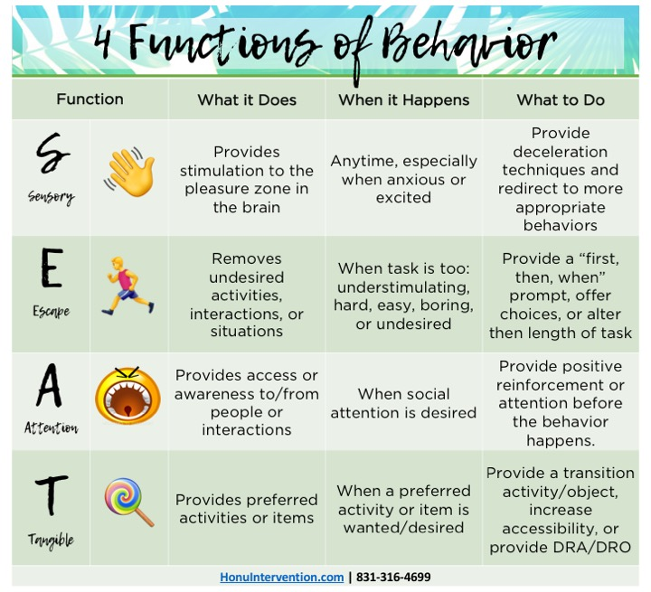

Slide 19
Date | Time | Antecedent (What happened directly before the behavior.) | Behavior (Describe the problem behavior in specifics.) | Consequence (What happened directly after the behavior.)
11/7 | 8:55 | Given a computer assignment | Refusal to follow instructions, put head down, pushed computer off desk | Called Mr. H. Student went with him to finish the assignment.
11/8 | 11:40 | Asked to do a social studies task | Ripped up paper, threw pencil down, put head down. | Gave cool down time, then a think sheet. Did assignment at recess.
11/9 | 1:30 | Taking a math test | Scribbled all over test, threw pencil, shouted, “This is stupid.” | Called Mr. H. Student went with him to finish test.

Slide 20
Next, we analyze the data and look for patterns.
In the case of the student in the example, it appears the function of the behavior is escaping tasks.
However, before drawing conclusions, it’s important to look at the whole picture. This includes considering skill deficits, time of day, known home factors, peer interactions, etc as well.
Instruments that can be used to help the team confirm their hypothesis include:
  Questions About Behavioral Function (QABF)
  Problem Behavior Questionairre

Slide 21
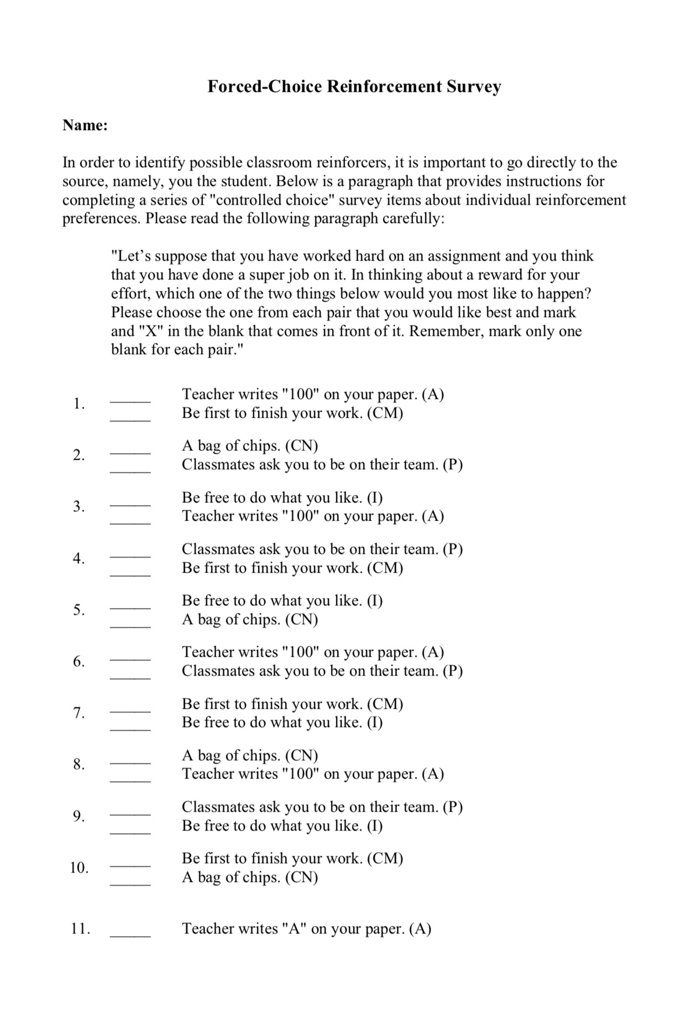
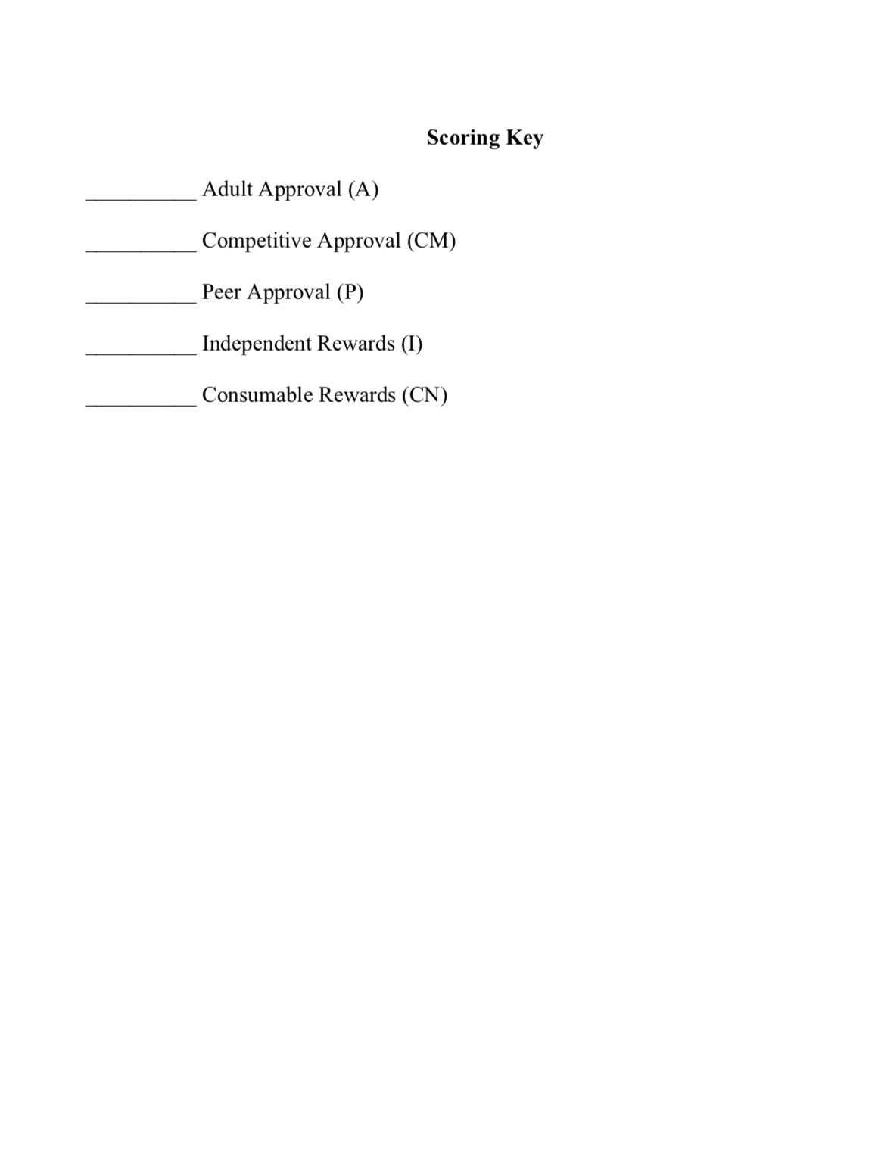
Determine Preferred Reinforcers
Forced Choice Reinforcer Survey Tips
Ask the child about favorite snacks and free time activities.
Substitute for the items mentioned in the survey.
Ask about favorite adults and friends in the building.

Slide 22
Implementation Steps
Create a check in/check out card.
Build a reinforcer menu based on a continuum of least to most powerful reinforcers.
Put antecedent strategies into place in the general education classroom.
Provide specialized instruction for short but frequent periods of time matched to the hypothesized function, identified skill deficits and desired replacement behaviors.
Record observed behavior in regular intervals in the general education classroom.
Conference with the student 2-3 times per day to receive feedback and reinforcement.
Home Communication

Slide 23
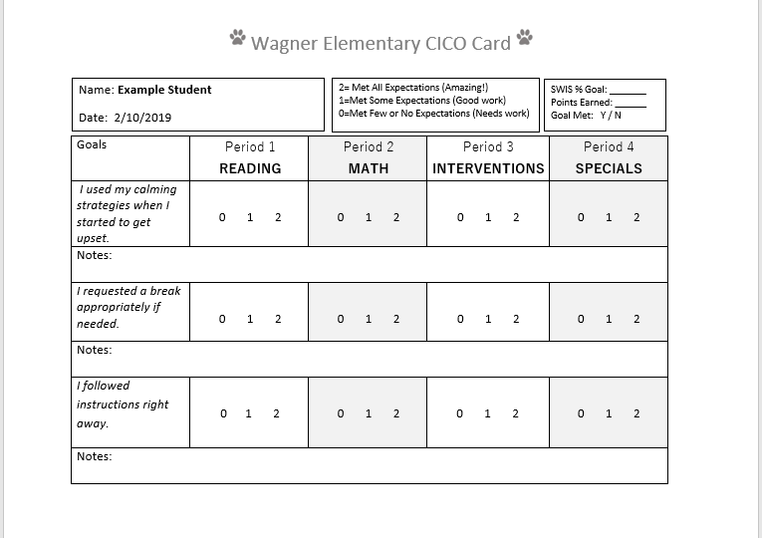
Creating/Introducing a Check In/Check Out Card
Tips for Creating a CICO Card
No more than 3 goals.
Align goals to identified problem behaviors.
Use a Likert scale (0, 1, 2) to allow more flexibility in scoring.
Set your reporting times. This will depend widely on the age and environment the child is in.

Slide 24
Create A Reinforcer menu
Consumable Rewards (5-10 pts) | Independent Rewards (10-20 pts) | Adult Attention (21-24+ pts)
*Goldfish crackers | *Computer Time | *Shoot baskets with Mr. H
*Jolly Ranchers | *Kinetic Sand | *Play Uno with Mr. H
*Orange slices | *Legos | *Lunch with teacher (100 pts)
*Animal Cookies | *Big Picture Books | *Lunch with principal (200 pts)
Tips for the Reinforcer Menu
Remember, it’s not a reinforcer unless the child wants it.
Order items from least to most powerful reinforcers.
Weight points goals so that a child is nearly certain to earn a reinforcer each day, even if it’s a small one. The goal is success.
If the child can handle long term goals, a point bank can be used to keep track toward the prize.

Slide 25
Antecedent Strategies
  Antecedent strategies are preventative actions to help reduce behavior.
  With our example student, we may provide one or more of the following: additional instruction, alternative work place, break assignments down into chunks with frequent teacher checkins, reduce the assignment, or alter its appearance to reduce frustration.

Slide 26
Other Examples Of AnteceDent Strategies
Preferential Seating
Noise Canceling Headphones
Alter or reduce lighting/sounds/smells that may be annoying
Peer Support
Reducing contact with peers who may exacerbate issue
Visual Schedules
Visual Timers
Fidgets/alternative seating

Slide 27
Specialized instruction
Instructional time and frequency will depend on the individual needs of your students.
However, it should be consistent, structured and related directly to the goals set based on the child’s problem behaviors.
For the example student, I would probably start with Zones of Regulation, found on socialthinking.com. There are many other programs out there as well, including Skill Streaming, PATHS, Social Thinking, Whole Body Thinking, Incredible Flexible You, We Thinkers, Superflex, Social Detective and the Incredible 5 point scale.

Slide 28
Daily Behavior Conferencing-Morning
Sets the tone for the day
Provides behavioral focus
Verbal encouragement and motivation
Helps screen for setting events
Role Play

Slide 29
Recording Behavior in the General Classroom
Ask classroom teachers to do these things at the designated times:
  Mark all periods. Even if a student isn’t doing the labeled activity, they are still somewhere during that time.
  Record in the notes section why a student earns a 0 so coaches can give constructive feedback.

Slide 30
Daily Behavior Conferencing-End of the Day
Keep it positive (Behavior Specific Praise)
Celebrate accomplishments/successes
Goal not met…. “try again tomorrow”
Reinforce the student or record points in bank according to the child’s point menu.

Slide 31
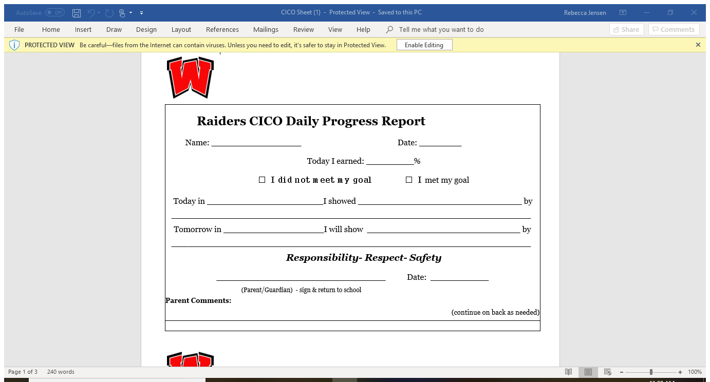
Home Communication
Provides an opportunity for the student to reflect on the day.
Is valuable for home/school consideration.
Can earn a treat or bonus point for returning the card signed by parent.
This is not a data keeping method, so keeping returned copies is not required.
  One idea is to celebrate signed sheets with 90% or above.

Slide 32
Monitoring
Graph data daily on graph paper, a spreadsheet or on SWIS CICO.
Review data every 2-4 weeks to determine if the program needs adjustment.
    If the child is struggling, consider adding additional supports like counseling, reevaluating instruction, making sure the antecedent strategies are being used, and making sure the reinforcement menu is on target.
    If the child is successful for 8 or more weeks, consider whether support can begin to fade.

Slide 33
Fading Supports
Fading supports will be individualized for each child. However, an important component of this process will be to teach the student to self monitor his or her own behavior.
Fading supports should be a team consideration, taking into account upcoming transitions, triggering events and social/emotional needs.

Slide 34
Thank you for attending today!
Contact me any time: Rebecca.Jensen@k12.sd.us
Resources related to this presentation can be found at:
http://www.wagner.k12.sd.us/District/Class/62-Rebecca-Jensen-s-Classroom/News/
Information about the Adventure Boy Series can be found at: https://www.facebook.com/oakshousepublishing/posts/

